Slide 1
NBA Shot Data Visualization
Hack princeton workshop 4/2/16
Anna Matlin
amatlin@princeton.edu

Slide 2
End goal
Shown on right: visualized shot data for Steph Curry of the Golden State Warriors
By the end of this workshop, we will have this plot displayed in a Shiny application, with player options and information

Slide 3
Resource dump
All code used in this workshop: https://github.com/amatlin/NBAvis
Stats data retrieved from http://www.nba.com/warriors/stats
Scraping:
https://www.crummy.com/software/BeautifulSoup/bs4/doc/
http://web.stanford.edu/~zlotnick/TextAsData/Web_Scraping_with_Beautiful_Soup.html (tutorial)
Shiny:
http://shiny.rstudio.com/
http://shiny.rstudio.com/articles/cheatsheet.html
Download python: https://www.python.org/downloads/
Download R and Rstudio:
http://lib.stat.cmu.edu/R/CRAN/
https://www.rstudio.com/products/rstudio/download/
ggplot2:
http://ggplot2.org/
https://www.rstudio.com/wp-content/uploads/2015/03/ggplot2-cheatsheet.pdf
Lots of code used from http://thedatagame.com.au/2015/09/27/how-to-create-nba-shot-charts-in-r/

Slide 4
Step 1: Have Python and R installed
Python needed for web scraping
R, RStudio needed for visualization + Shiny

Slide 5
Step 2: go to Github repository
https://github.com/amatlin/NBAvis
→ open README and follow instructions for installation of necessary packages

Slide 6
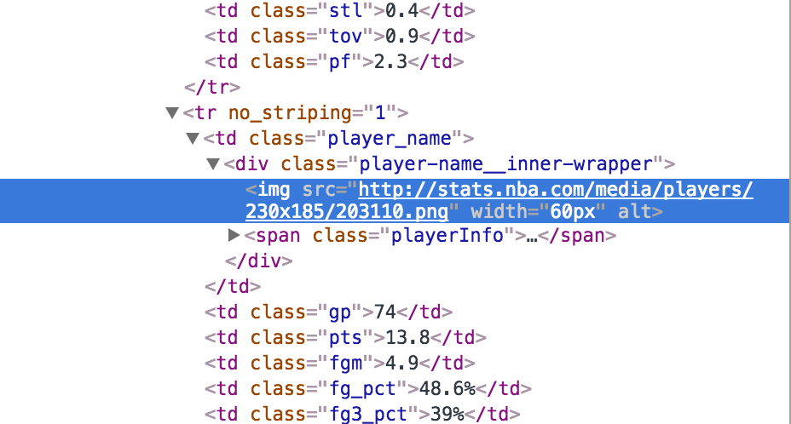
Step 3: Scraping
Go to http://www.nba.com/warriors/stats to get a look for what we will be scraping.
Player IDs come from image links in HTML.
Find image of player, right click and select “Inspect”
Frameworks/APIs we will be using to scrape:
→ Beautiful Soup

Slide 7
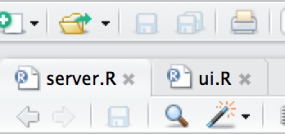
What is a Shiny app?
Check out http://shiny.rstudio.com/ for documentation + tutorials
→ “A web application framework for R; Turn your analyses into interactive web applications; No HTML, CSS, or JavaScript knowledge required”
→ each app is made containing two files
server.R: behind the scenes calculations
ui.R: what the user sees
→ designed for development in RStudio
→ Terms to keep in mind: render, reactive, input/output

Slide 8
Step 4: Start making our app

Slide 9
Step 5: ggplot2
For more info check out
http://ggplot2.org/
https://www.rstudio.com/wp-content/uploads/2015/03/ggplot2-cheatsheet.pdf
“ggplot2 is a plotting system for R, based on the grammar of graphics, which tries to take the good parts of base and lattice graphics and none of the bad parts. It takes care of many of the fiddly details that make plotting a hassle (like drawing legends) as well as providing a powerful model of graphics that makes it easy to produce complex multi-layered graphics.”

